Slide 1
Team 2 Final Report
GAMEGUIDESINC

Slide 2
Website/Project
We have a finished website design done
We have a place for our personal information, but are not adding it.
All links are up and running
Did have a working comments connected to a mysql database but when there are issues

Slide 3
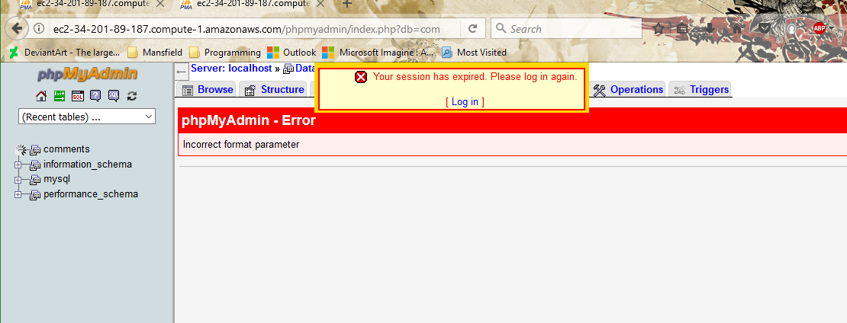
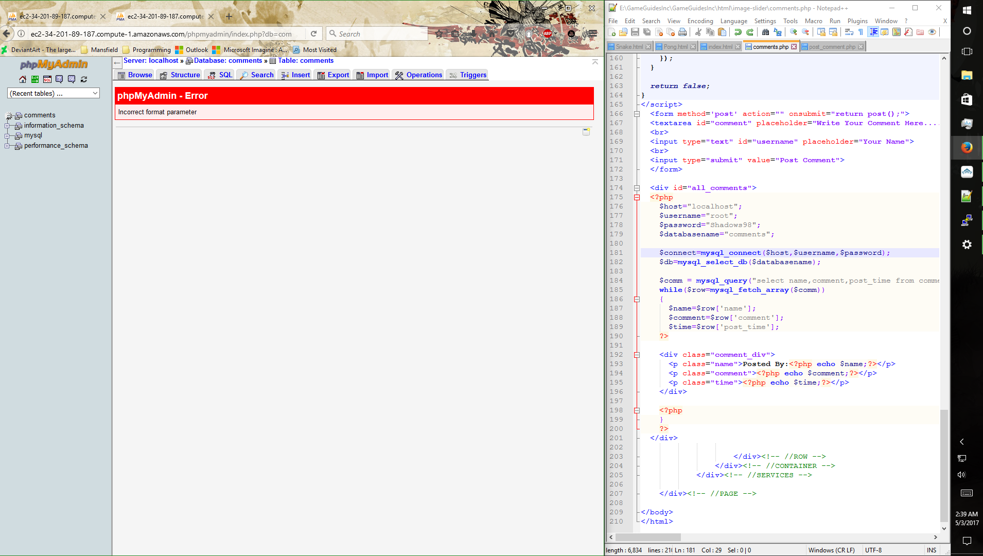

Slide 4
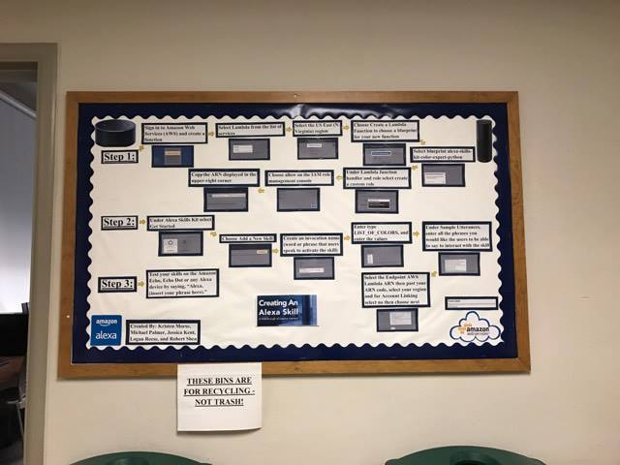
Bulletin Board
We are doing our bulletin board on Alexa skills.
Its currently up and finished.

Slide 5
Snake and Pong/Retro Games
We added both games to the website. Both are playable and keep track of your score
We couldn’t figure out asteroids.

Slide 6
Service Project
We are using Alexa units to activate led lights in the State Farm lab.
During the power outage yesterday, we lost all of our work in the state farm lab. For some reason a computer isn’t hooked into the surge protector?

